Slide 1
Data Challenge
Andrew Rusinko
5/25/2017

Slide 2
Problem
Predict the conversion rate of a new generic entering the market. Accuracy should increase over time.
Data provided was the first purchase date and customer commit date amongst other fields.
Collected into cohorts aggregated by purchase date (i.e., Cohorts1-31) and the number of conversions by date.
Initial raw data file had to be sorted by purchase, then commit dates to facilitate future processing
All python scripts were run on Linux Mint using Python 2.7.11 (Anaconda).
05/01/2013 ,001,0,0.0433493886625
05/02/2013 ,001,1,0.0615042608373
05/03/2013 ,001,2,0.0703964431271
05/04/2013 ,001,3,0.0741015190811

Slide 3
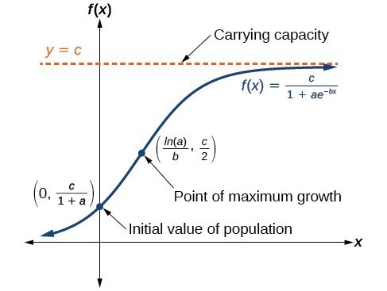
Logistic Growth Model
Track = 0 or Day#0
I initialized the cohort and calculated an initial value of a based on a guess at the conversion rate c.
a = c /y₀ -1
Track = 1 or Day#1
I calculated an initial value of b based on constant a.
c = (1 + a) * y₀
c= (1 + ae^{-b}) * y₁
Solving for b:
b = -ln ( (y₀/y₁ + y₀/y₁a -1) /a)
And then c was recalculated using constant a and b.
Track = 2 or Day#2
Fsolve (scipy curvefit) was used to estimate the values of b and a. Then c was computed from the y value on Day#2.
c= (1 + ae^{-2b}) * y₂
Started with an initial estimate of conversion rate, gamma0.
Two statistics to monitor would be the initial rate and the point of maximum growth (equivalent to an EC₅₀).
https://courses.lumenlearning.com/precalcone/chapter/use-logistic-growth-models/

Slide 4
Constrained Optimization Yields Reasonable Results
Track = 3+ or ALL remaining days in study
Fsolve was used to estimate the values of a,b,c using constrained optimization of a and b.
For each day, the mean of the conversion rate per cohort was also computed.
NewDate: 05/01/2013
Cohort1 0 0.25 0.0 0
Average Conversion Rate = 0.25
NewDate: 05/02/2013
Cohort1 1 0.293349388662 4
Cohort2 0 0.25 0.0 0
Average Conversion Rate = 0.271674694331
NewDate: 05/03/2013
Cohort1 2 0.286738076198 5
Cohort2 1 0.295705279748 4
Cohort3 0 0.25 0.0 0
Average Conversion Rate = 0.277481118649
NewDate: 05/04/2013
Cohort1 3 0.274020866258 7
Cohort2 2 0.28638803504 7
Cohort3 1 0.292415859843 5
Cohort4 0 0.25 0.0 0
Average Conversion Rate = 0.275706190285
NewDate: 05/05/2013
Cohort1 4 0.247290622687 8
Cohort2 3 0.26642763016 8
Cohort3 2 0.289813389882 6
Cohort4 1 0.296820809249 5
Cohort5 0 0.25 0.0 0
Average Conversion Rate = 0.270070490396

Slide 5
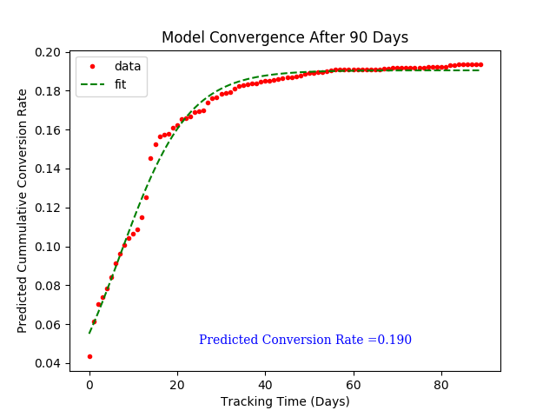
Model Does Indeed Converge

Slide 6
Validation
Randomly chose points (cohort, track) and compare predicted vs observed conversion rates
Chose predictions for all cohorts on specific intervals
Alternative:
Model first 21 cohorts then use an ensemble model to predict next 10 days.
Leave some data out as a test set for prediction.

Slide 7
Predictions for Mature Cohorts Are More Accurate
Randomly chosen points

Slide 8
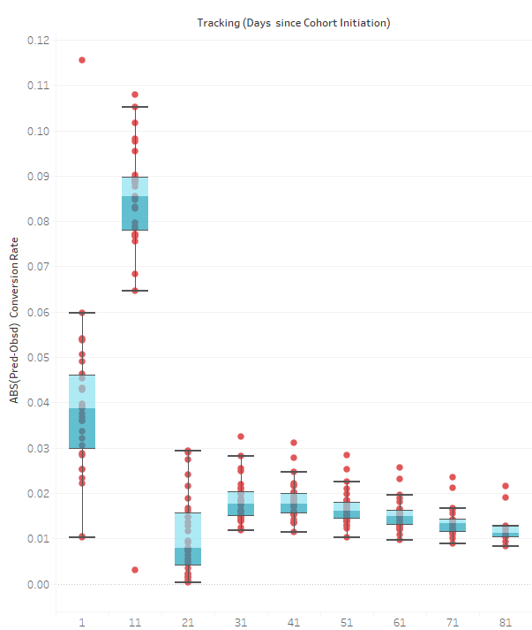
Conversion Rate Predictions Improve with Time

Slide 9
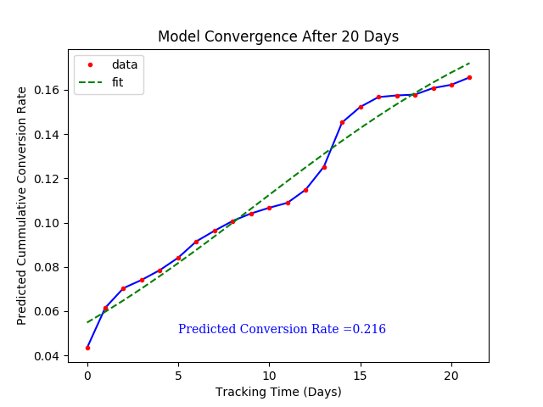
Sidebars
Data shows some interesting anomalies
Rates start to plateau at about 10 days then pick up again
Weekend sales are weaker and pick up again on Mondays
Did not check the influence on rate due to US/foreign purchase, day of the week, time of day etc.
Better model would include the second rise and ultimate plateau.

Slide 10
Summary
Python code was used to first clean up challenge data then model it.
Models were built on the fly with data as it appeared.
Day in study cohort (track) and cumulative conversion rate were used in modeling data
Models became increasingly more accurate with time.
Perhaps it might be possible to estimate number of generic widgets that would need to be manufactured in a future period.

